Slide 1
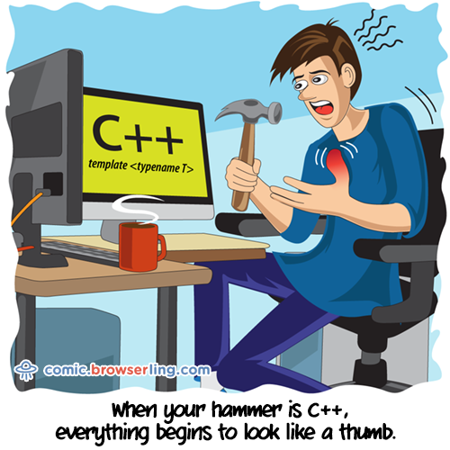
C++ Language
Language Elements and Structure
"If builders built buildings the way programmers wrote programs, then the first woodpecker that came along would destroy civilization." - Gerald Weinberg

Slide 2

Understand the four basic programming language elements
Get familiar with Visual Studio
Develop a project file template
Review the build process
Learn how to debug in Visual Studio

Slide 3
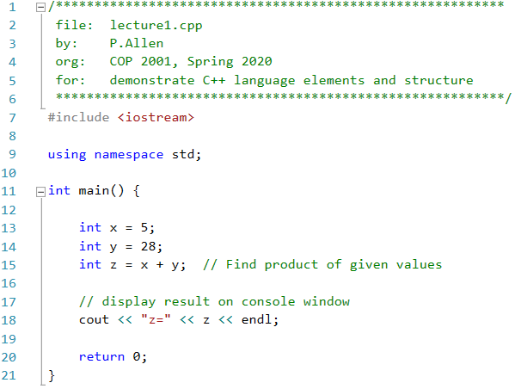
Language Elements
Comments
Compiler Directives
Declaration Statements
Executable Instructions

Slide 4
Comments
Comments provide specifications, audit history, logic, debugging information, and are vital to the readability and maintenance of programs
Multiline comments “/* … */” – used to create block comments that can span multiple lines
Single line comments “// …” –
place at the end of lines of code to provide logic relating to the instruction
Place above lines of code to document a block of instructions
Spelling out variable and function names helps self-document code. Do not use single-letter variable names like “x” or “y” unless the variables refer to (x,y) coordinates. Use variable names like “sum” or “price”. The use of “i” is common as a loop index variable or an array index and is acceptable.
Comments do not end up in executable object code

Slide 5
Compiler Directives
Used to modify source code and or include library code
Processed by either the pre-processor or compiler
Most directives begin with the pound-sign “#”
Include directive – used to include header files for system, language, or project libraries
#include <…> - search the compiler library path for files with extensions “.h” or “.hpp”
#include “…” – look in the project source code directory for the file name specified
Using namespace … - specifies the namespace for packages to include libraries of functions and class object methods and properties
All source code in file “iostream.h” and any headers included inside iostream is copied by the pre-processor to output file “lecture1.i” with lines 11-20 of the current source code file.
cout << "z=" << z << endl;
without directive
std::cout << "z=" << z << std::endl;
Compiler directive statements do not end up in executable object code

Slide 6
Declarations
Declaration statements define variables, functions, complex data types like string or arrays, structures, classes, etc.
Variable declarations reserve memory in the data segment or within the stack segment for functions
Function declarations provide a label that translates to an address that can be used as a jump-target for branching instructions like a CALL, and they may reserve memory for return values
Data structure declarations define a block of memory that will be reserved for any variable declared of that structure type
We will look at other types of declarations later in the course
Declarations are processed by the pre-processor and compiler to organize data segments and replace labels with offsets/addresses of instructions as targets for branch instructions

Slide 7
Executable Instructions
Code the performs an operation, such as arithmetic, logic, data-transfer, branching (if, while, function call/return), dynamic data instantiation (new class objects), etc.
Instructions are processed at runtime
Instructions are processed sequentially unless a branching instruction changes the next instruction to be fetched (change the value in the PC register)
High-level languages like C++ may combine data declaration and executable instructions in source code (will be broken up by the compiler)

Slide 8
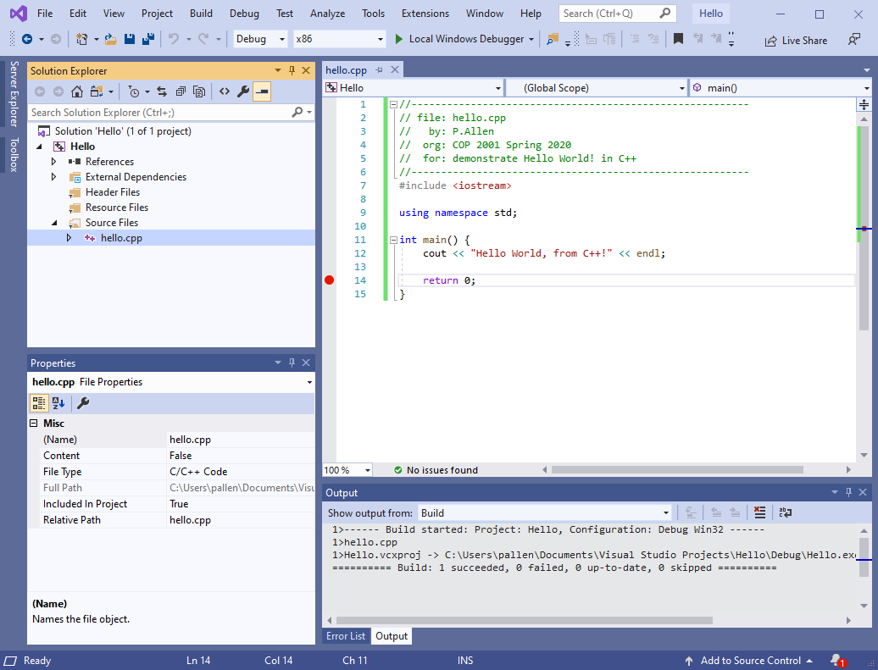
Visual Studio
Build & Debug Menus
Editor
Solution Explorer
Solution
Breakpoint
Project
Output Window
Files:
Source (.cpp) Header (.h)
Window Tabs
Properties

Slide 9
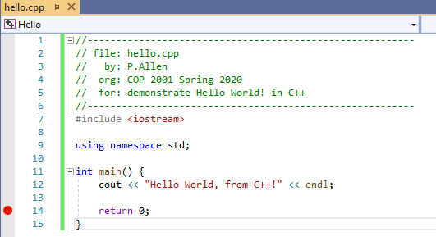
Create Hello World!
Select [Create a new project]
Select “Empty Project” for C++ Windows Console
Name the project, for instance “Hello”
Select a location (easiest is to create a projects folder in your “c:\<username>\Documents” folder)
Check the “Place solution and project in the same directory” checkbox
Select the Create button
In the Solution Explorer, right-click “Source Files” and select “Add -> New Item”
Select C++ File (.cpp)
Name the file, for instance “hello.cpp”
Click “Add”
Type the Source code shown for Hello World!
Do NOT Build Yet!

Slide 10
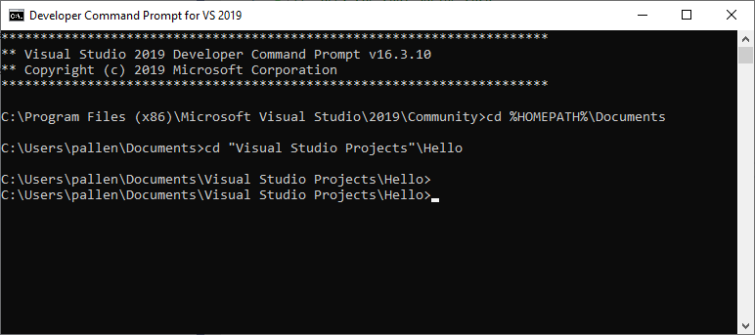
Build Hello World! from Command Line
Launch the [Developer Command Prompt for Visual Studio 2019]
Navigate to your project folder
cd %HOMEPATH%\Documents
cd “Visual Studio Projects”\Hello
cd – change directory
%HOMEPATH% - environment variable for your login
Note: use of double quotes around parts of paths that have a space in them

Slide 11
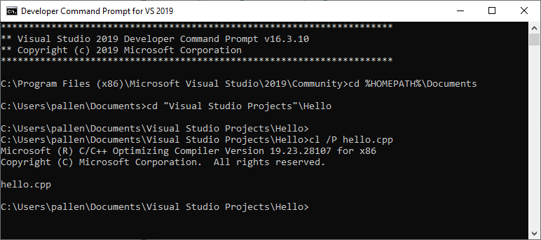
Run the C++ Pre-Parser
Run command:
cl /P hello.cpp
Look in your project folder for “hello.i”
Open this file in a text editor

Slide 12
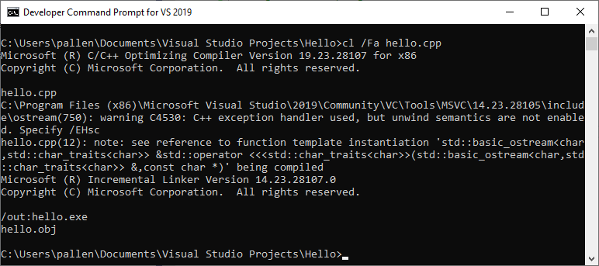
Run the C++ Compiler/Assembler/Linker
Run command:
cl /Fa hello.cpp
Open each file in a text editor
hello.asm
hello.obj
hello.exe
Which step created each?
Run command
hello.exe
The Assembler and Linker command line statements are too long and difficult to run individually, so we let the compiler tool “cl” run all of them with default values other than a flag to generate the Assembler listing file

Slide 13
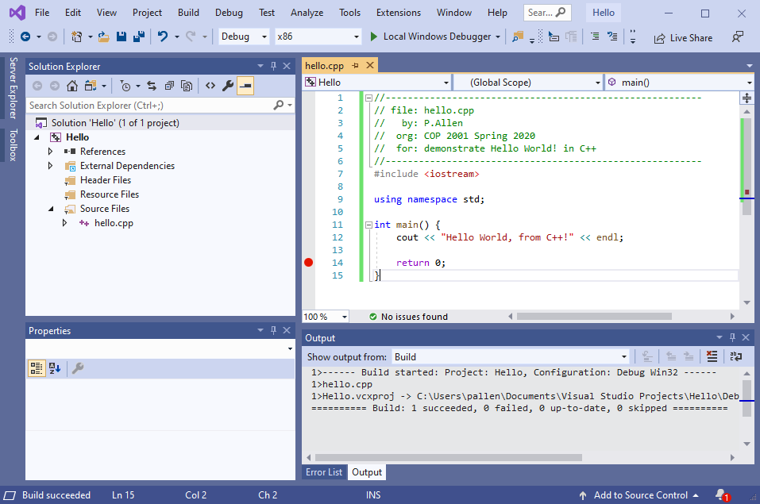
Build Hello World! in Visual Studio
Under the [Build] menu
[Build Solution]
or
[Build Hello]
Look in the Output window for results of the build

Slide 14
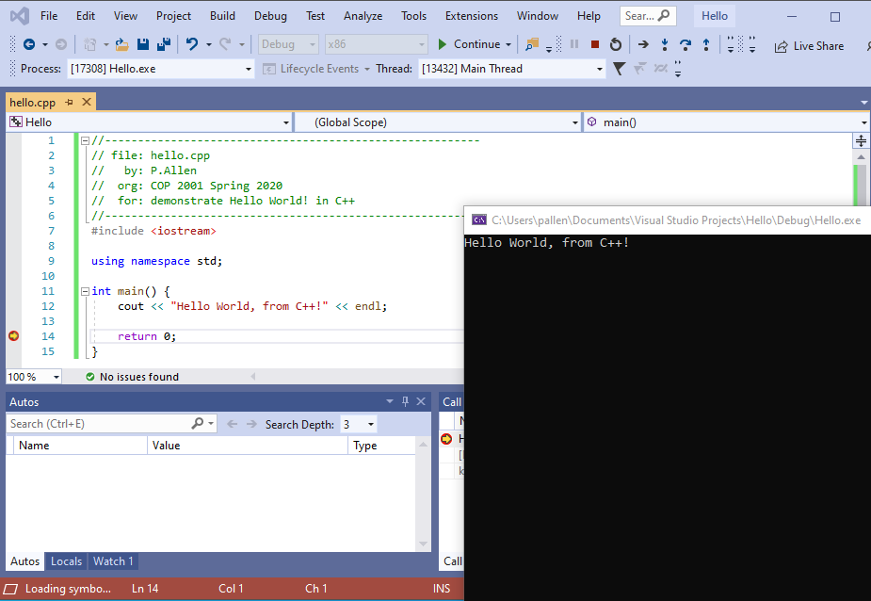
Debug Hello World! in Visual Studio
Set a Breakpoint on the “return 0;” line
Click in the grey bar left of the line
or
Click on the line and choose [Toggle Breakpoint] in the [Debug] menu
Click [Start Debugging] in the [Debug] menu
Bring the Console Window to the front
Choose [Continue] or [Stop Debugging] from [Debug]

Slide 15


Slide 16
What are the four programming language statement types?
?

Slide 17
Which of the four programming language statement types will not exist in executable object code?
?

Slide 18
What are the four steps of the build process?
?

